Slide 1

Electrical instruments and c.r.o.
A Short Presentation By Varun Gaur

Slide 2
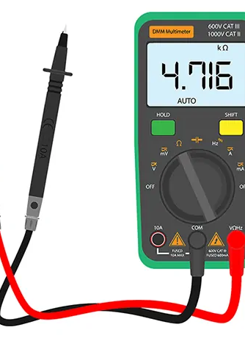
Electronic Instruments
The instruments which acts a electronic devices, but for measuring electrical quantities are commonly known as electronic instruments.
Electrical Instruments covered most of electrical quantities to measure.
Appropriate instruments are used in variety of conditions.

Slide 3
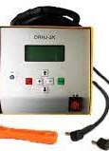
List of electronic instruments
There are numerous instruments that we have used till now, few of them are:
Galvanometer
Multimeter
Meter Bridge
Electronic Voltmeters (VTVM, Transistor, B.R. VM)
Cathode Ray Oscilloscope

Slide 4
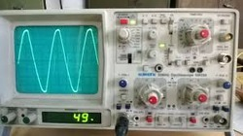
Cathode ray oscilloscope (c.r.o)
Electronic Device which is capable of giving a visual indication of a signal waveform.
It has no alternate device. The oscilloscope can also be used for measuring voltage, frequency and phase shift.
Cathode Ray tube is the brain of this oscilloscope. It’s a vacuum tube of special geometrical shape and coverts an electrical signal into visual one. It consists of plenty of electrons, responsible for device’s visualization.

Slide 5
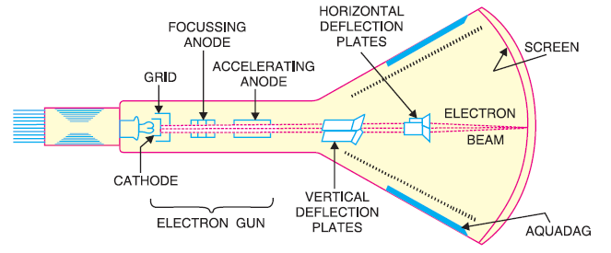
Construction of c.r.T
Maintained at +ve potential
Maintained at –ve potential
Nickel Cylinder coated with oxide
Inner walls between neck and screen, made up of conducting material

Slide 6
WORKING & APPLICATIONS OF C.R.T/c.r.o
The control grid contains the cathode, shaping itself as a tiny but long cylinder. Responsible for a narrow beam.
The focussing anode focusses the electron beam by controlling positive potential on it.
Since accelerating anode has greater potential than focussing one, the narrow beam moves itself as high velocity.
It finally hits the screen as a spot of light.
Applications:
Used in Trouble shooting the radio and television receivers
Laboratory work involving research and design,

Slide 7


